Slide 1



ULTRASONIC PEENING SOLUTIONS

Slide 2
WHAT IS RESIDUAL STRESS?
Residual stresses are stresses that remain in a solid material after the original cause of the stresses has been removed.
It is divided into two different types of residual stresses which is known as desirable and undesirable residual stresses.
For welded joint, R.S primarily develop due to differential weld thermal cycle (heating, peak temperature and cooling at the any moment during welding) experienced by the weld metal and region closed to fusion boundary i.e. heat affected zone.
Presence of undesirable R.S in the weld joints can encourage or discourage failures due to external loading as their effect is additive in nature.
There’s a need for a systematic solution which utilised capability of technology in measuring R.S and treatment of R.S.

Slide 3
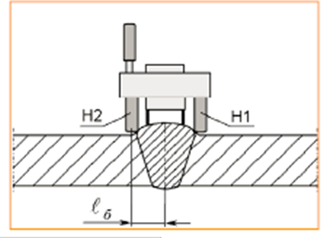
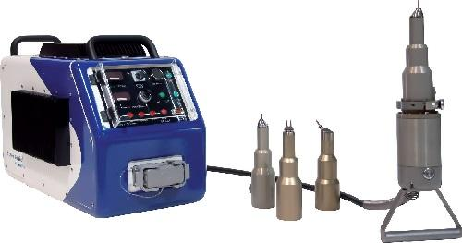
WHAT IS ULTRASONIC PEENING SOLUTIONS?
It is an enhanced solution which been developed by MRA International Sdn Bhd as part of integrity solution for asset owner in enhanced the fatigue-life of welded joint.

Slide 4







WHY ULTRASONIC PEENING SOLUTIONS?
Improved brittle fracture
Residual Stress Measurement
ULTRASONIC
PEENING
SOLUTIONS
Increase Fatigue Strength
Increased Surface Quality
Improved Strength of Material
Increased surface hardness

Slide 5




ULTRASONIC PEENING TECHNOLOGY RECOGNITION
Fatigue strength improvement of steel structures by high-frequency mechanical impact: proposed procedures and quality assurance guidelines15. • Fatigue strength improvement of steel structures by high-frequency mechanical impact: proposed fatigue assessment guidelines 23
“GUIDE FOR THE FATIGUEASSESSMENT OF OFFSHORE STRUCTURES
AMS 2580 This specification covers the requirements for inducing compressive residual stresses on the surface of metal parts using ultrasonically activated shot peening..
Others
Llyod register, Bureau Veritas, American Association of State Highway and Transportation Officials (AASHTO) and Federal Highway Administration (FHWA) Recommendations,
Advantages
Improvement of Fatigue Strength, Corrosion Resistance, grain refinement and grain size reduction

Slide 6
GUIDING DOCUMENT
Title | Publisher | Years
Fatigue Life Assessment of Bridge Details Using Finite Element Method | Chalmers University of Technology | 2012
Fatigue Behaviour of welded High-Strength Steels | Dept. of Aeronautics, The Royal Institute of Technology, Stockholm, Sweden | 1997
Fatigue behaviour of high-strength steel-welded joints in offshore and marine systems (FATHOMS) | European Commission - Research Fund for Coal and Steel | 2010
Fatigue Life Extension Procedure by Ultrasonic Peening | International Institute of Welding | 2010
Introductory fatigue tests on welded joints in high strength steel and aluminium improved by various methods including ultrasonic impact treatment (UIT) | International Institute of Welding | NA
Overview of fatigue data for high frequency treated welded joints | International Institute of Welding | NA
Pulse laser acoustics for the characterization of inhomogeneities at interfaces of microstructures | Center of Mechanics, ETH, Swiss Federal Institute of Technology, CH 8092 Z€urich, Switzerland | 2004
 | b Ion Beam Physics, ETH H€onggerberg, Swiss Federal Institute of Technology, CH 8093 Z€urich, Switzerland
Life Extension of Class F and Class F2 Details Using Ultrasonic Peening | International Institute of Welding | NA
Structural Fatigue and Life Extension of Offshore FPSOs by Means of Ultrasonic Peening | Scandinavian Oil-Gas Magazine | 2012

Slide 7
HOW ULTRASONIC PEENING SOLUTIONS WORK?
Procedure Development
Ultrasonic Peening Assessment
Report Preparation

Slide 8
PROCEDURE DEVELOPMENT
WELDING SPECIALIST/ ENGINEER
MMM & NDE SPECIALIST
PROCEDURES

Slide 9
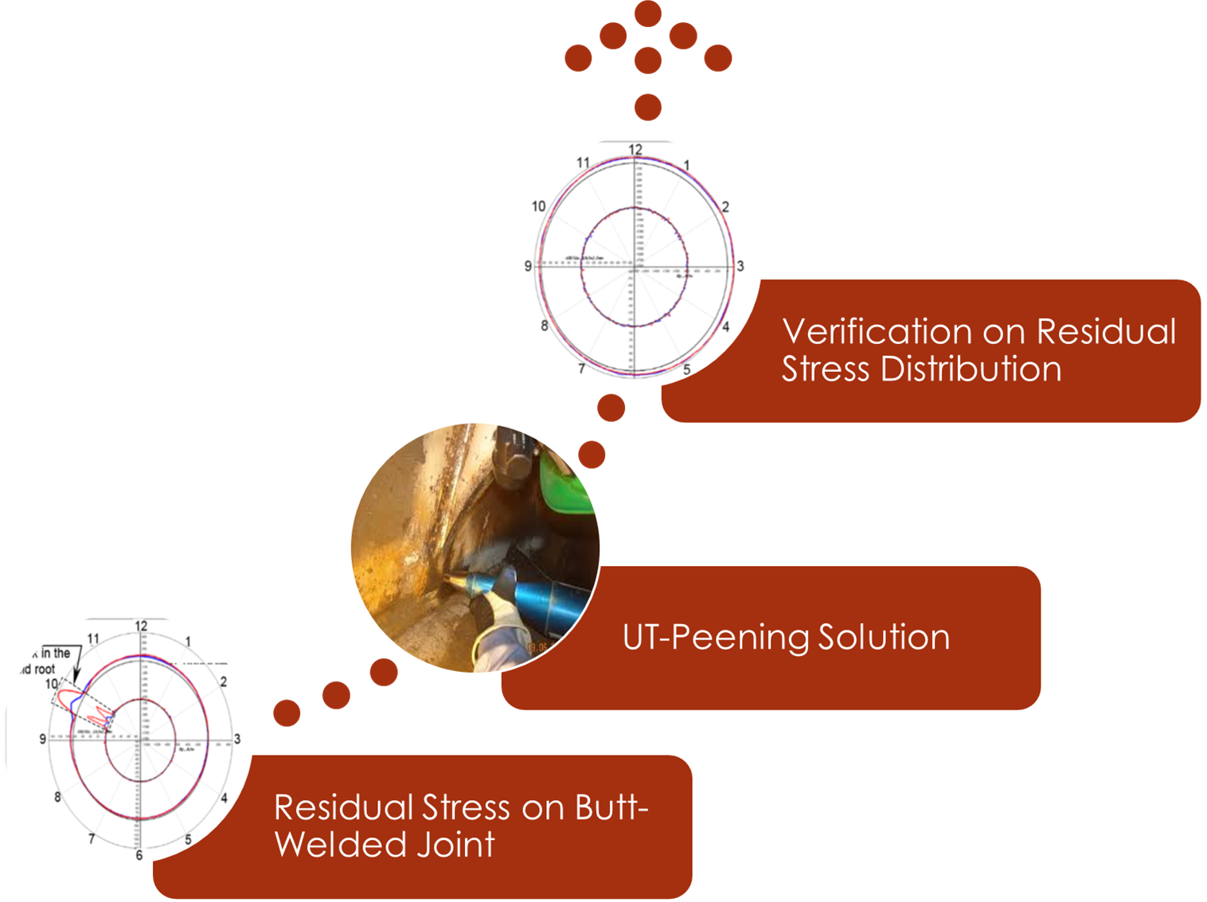
ULTRASONIC PEENING SOLUTIONS

Slide 10


Provides various solutions of asset integrity assessment
utilising the capability of latest NDE technology and current inspection approach in obtaining the data gathering for integrity assessment purposes.

Slide 11
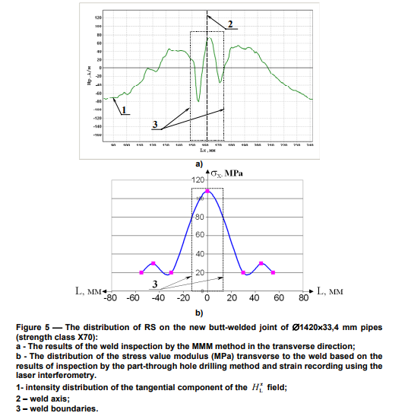
COMPARATIVE BETWEEN RESIDUAL STRESS MEASUREMENT TOOLS
A.Dubov, S.Kolokolnikov, “Problems of welding residual stresses testing and their solution based on using method of metal magnetic memory “

Slide 12
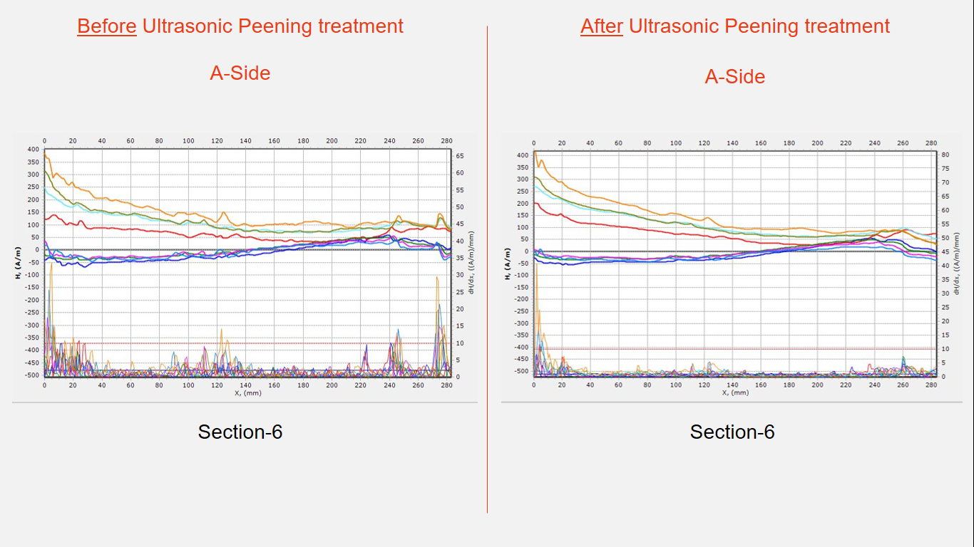
DATA MEASUREMENT BEFORE & AFTER UPT
SCZs Area
Acoustic Softening Effect
Treated SCZs Area

Slide 13
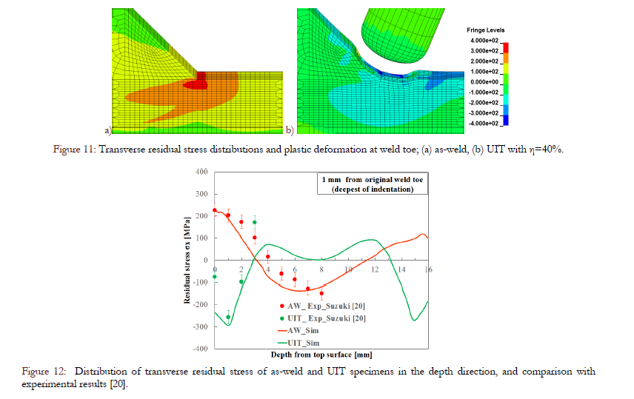
Reduction of Residual Stress
K.L. Yuan et alii, Frattura ed Integrità Strutturale, 34 (2015) 476-486; DOI: 10.3221/IGF-ESIS.34.53 «Modelling of ultrasonic impact treatment (UIT) of
welded joints and its effect on fatigue strength”

Slide 14
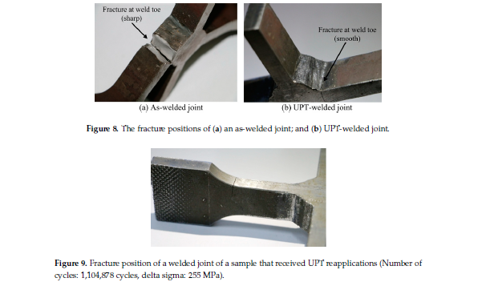
Improves brittle facture resistance of welded joints.
Xiaohui Zhao 1, Mingyi Wang 1, Zhiqiang Zhang 1,* and Yu Liu 2 “The Effect of Ultrasonic Peening Treatment on Fatigue
Performance of Welded Joints” MDPI Journal 2016

Slide 15
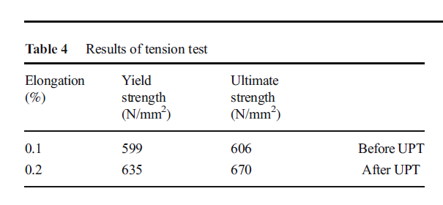
Improves strength of material
Alireza Abbasi 1 & Saeid Amini 1 & Ghanbar Ali Sheikhzadeh1
“Effect of ultrasonic peening technology on the thermal fatigue
of rolling mill rolls” International Journal of Manufacturing Technology

Slide 16
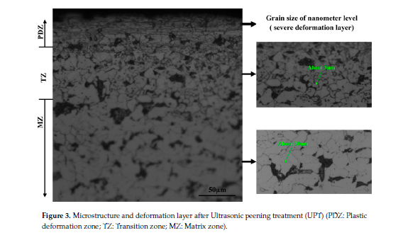
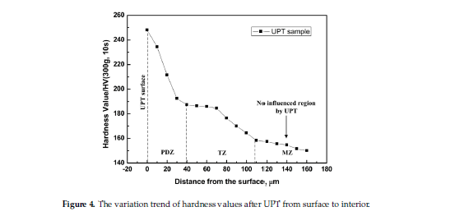
It increases surface hardness

Slide 17
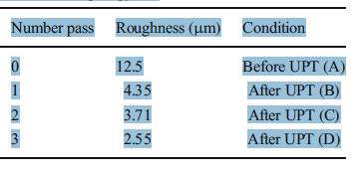
Increased surface quality
Alireza Abbasi 1 & Saeid Amini 1 & Ghanbar Ali Sheikhzadeh1
“Effect of ultrasonic peening technology on the thermal fatigue
of rolling mill rolls” International Journal of Manufacturing Technology

Slide 18
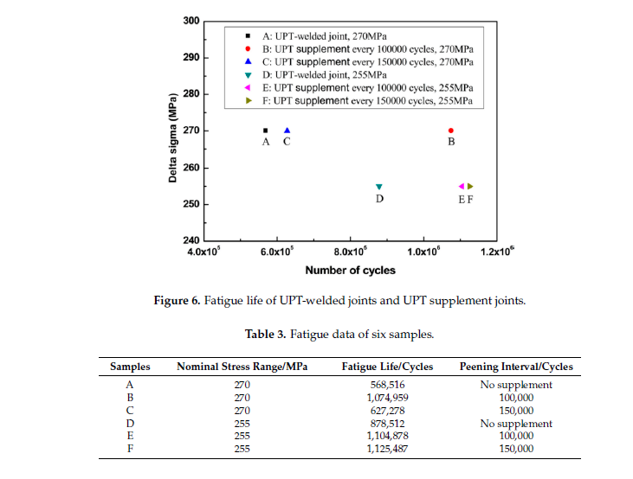
Improved Fatigue strength of Welded joint
Xiaohui Zhao 1, Mingyi Wang 1, Zhiqiang Zhang 1,* and Yu Liu 2 “The Effect of Ultrasonic Peening Treatment on Fatigue
Performance of Welded Joints” MDPI Journal 2016

Slide 19
Provides various solutions of asset integrity assessment
utilising the capability of latest NDE technology and current inspection approach in obtaining the data gathering for integrity assessment purposes.

